Slide 1


RBFNN
Ha-Rang Kim
25.3.9
ⓒSaebyeol Yu. Saebyeol’s PowerPoint

Slide 2
Table of contents
1
A Study on the Design of RBFNN Applied with the Aid of a Novel Learning Method: Focused on Improvement of Performance of Prediction Model and Pattern Classifier

Slide 3
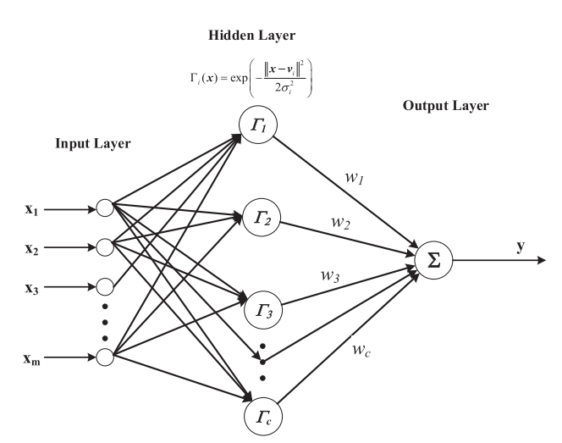
A Study on the Design of RBFNN
RBFNN
Global optimal approximation
Classification capabilities
Rapid convergence

Slide 4
A Study on the Design of RBFNN
Performance improvement of RBFNN
The location of radial basis functions (RBFs) in the input space Data containing outliers or noise
Learning the center and width of RBFs → Difficulty in learning due to constraints
Learning cluster centers(FCM) → Considering the centers as the locations of RBFs
Performance degradation of RBFNN due to incorrect learning
Assigning weights to adjust the participation of unnecessary data in learning → Mitigating performance degradation

Slide 5


A Study on the Design of RBFNN
Proposed RBFNN prediction model

Slide 6



A Study on the Design of RBFNN
Proposed RBFNN pattern classifier

Slide 7
A Study on the Design of RBFNN

Slide 8
A Study on the Design of RBFNN

Slide 9
A Study on the Design of RBFNN
Experiments and Discussion
Performance evaluation and comparison of the proposed prediction model and pattern classifier through experiments
Performance comparison with the previously used FCM-based RBFNN model
Performance comparison with various regression models and pattern classifiers implemented in the WEKA toolkit
Performance comparison using real-world application data

Slide 10
A Study on the Design of RBFNN

Slide 11
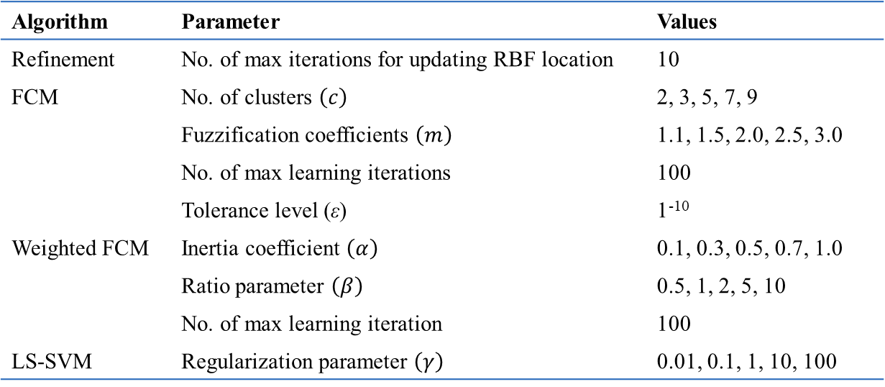
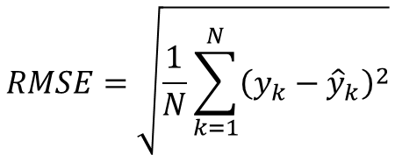
A Study on the Design of RBFNN
Regression
Evaluation of Performance
$$RMSE=\sqrt{\frac{1}{N}\sum_{k=1}^{N}{{\left(y_{k}−{\hat{y}}_{k}\right)}^{2}}}$$
Algorithm | Parameter | Values
Refinement | No. of max iterations for updating RBF location | 10
FCM | No. of clusters $\left(c\right)$ | 2, 3, 5, 7, 9
 | Fuzzification coefficients $\left(m\right)$ | 1.1, 1.5, 2.0, 2.5, 3.0
 | No. of max learning iterations | 100
 | Tolerance level (ε) | 1⁻¹⁰
Weighted FCM | Inertia coefficient $\left(α\right)$ | 0.1, 0.3, 0.5, 0.7, 1.0
 | Ratio parameter $\left(β\right)$ | 0.5, 1, 2, 5, 10
 | No. of max learning iteration | 100
LS-SVM | Regularization parameter $\left(γ\right)$ | 0.01, 0.1, 1, 10, 100

Slide 12
A Study on the Design of RBFNN
Regression (using Publicly available regression dataset)
Data name (Abbreviation) | No. of input variables | No. of data instances
Diabetes (DI) | 2 | 43
Servo (SE) | 4 | 167
MachineCPU (CPU) | 6 | 209
Friedman function1 (F1) | 50 | 250
Friedman function2 (F2) | 100 | 250
NOx | 5 | 260
Yacht (YA) | 6 | 308
Baseball (BA) | 16 | 337
Daily electricity energy (DEE) | 6 | 365
Auto MPG6 (M6) | 5 | 398
Auto MPG8 (M8) | 7 | 398
Electrical length (EL) | 2 | 495
Boston housing (BH) | 13 | 506
Forest fires (FF) | 12 | 517
Stock prices (SP) | 9 | 950
KELL, Weka Wiki

Slide 13

A Study on the Design of RBFNN
Regression
Data name (Abbreviation) | No. of input variables | No. of data instances
Laser (LA) | 4 | 993
Concrete compressive strength (CCS) | 8 | 1,030
Mortgage (MO) | 15 | 1,049
Treasury (TR) | 15 | 1,049
Electrical maintenance (EM) | 4 | 1,056
Friedman (FR) | 5 | 1,200
Weather Izmir (WZ) | 9 | 1,461
Airfoil (AR) | 5 | 1,503
Wine quality (WQ) | 11 | 1,599
Weather Ankara (WA) | 9 | 1,609
Plastic strength (PS) | 2 | 1,650
Quake (QU) | 3 | 2,178
Analcat (AN) | 7 | 4,052
Abalone (AB) | 8 | 4,177
Computer activity (CA) | 21 | 8,192
Tic (TI) | 85 | 9,822
KELL, Weka Wiki

Slide 14
A Study on the Design of RBFNN
Regression
Data | FCM-based RBFNN |  | Proposed RBFNN
 | Training | Testing | Training | Testing
Diabetes | 0.504±0.012 | 0.588±0.154 | 0.509±0.024 | 0.510±0.199
Servo | 0.507±0.027 | 0.633±0.199 | 0.334±0.025 | 0.495±0.178
MachineCPU | 34.511±2.112 | 46.045±15.806 | 25.819±0.854 | 39.899±12.284
Friedman function1 | 0.553±0.022 | 0.945±0.170 | 0.451±0.020 | 0.869±0.077
Friedman function2 | 0.239±0.029 | 2.506±0.618 | 0.700±0.015 | 0.881±0.161
NOx | 0.640±0.051 | 0.900±0.203 | 0.703±0.048 | 0.901±0.269
Yacht | 3.175±0.250 | 4.282±0.757 | 3.975±0.313 | 4.622±1.026
Baseball | 603.34±14.51 | 694.60±129.9 | 517.000±14.417 | 658.330±123.584
Daily electricity energy | 0.348±0.007 | 0.395±0.057 | 0.342±0.006 | 0.395±0.055
Auto MPG6 | 2.437±0.077 | 2.663±0.606 | 2.394±0.065 | 2.680±0.376
Auto MPG8 | 2.279±0.066 | 2.873±0.4839 | 2.321±0.049 | 2.684±0.570
Electrical length | 563.92±12.82 | 615.87±130.4 | 566.482±16.583 | 611.830±140.600
Boston housing | 2.759±0.066 | 3.688±0.614 | 2.763±0.078 | 3.365±0.583
Forest fires | 61.894±7.422 | 47.803±44.454 | 62.453±7.272 | 47.381±44.384
Stock prices | 0.760±0.023 | 0.863±0.072 | 0.739±0.020 | 0.814±0.094

Slide 15
A Study on the Design of RBFNN
Regression
Data | FCM-based RBFNN |  | Proposed RBFNN
 | Training | Testing | Training | Testing
Laser | 8.708±0.565 | 10.245±1.534 | 7.550±0.501 | 8.583±2.473
Concrete compressive strength | 7.060±0.140 | 7.742±0.887 | 7.021±0.118 | 7.629±0.649
Mortgage | 0.055±0.001 | 0.077±0.011 | 0.066±0.001 | 0.074±0.010
Treasury | 0.155±0.005 | 0.186±0.050 | 0.157±0.003 | 0.188±0.031
Electrical maintenance | 100.770±1.62 | 108.048±12.16 | 100.523±2.586 | 104.610±8.413
Friedman | 1.535±0.043 | 1.629±0.154 | 1.446±0.023 | 1.519±0.140
Weather Izmir | 1.102±0.012 | 1.146±0.117 | 1.080±0.022 | 1.133±0.175
Airfoil | 3.766±0.091 | 3.957±0.237 | 3.746±0.067 | 3.897±0.222
Wine quality | 0.622±0.005 | 0.639±0.052 | 0.623±0.007 | 0.638±0.050
Weather Ankara | 1.169±0.007 | 1.242±0.064 | 1.182±0.017 | 1.238±0.077
Plastic strength | 1.493±0.005 | 1.502±0.048 | 1.4193±0.008 | 1.506±0.079
Quake | 0.188±0.002 | 0.191±0.018 | 0.188±0.001 | 0.191±0.009
Analcat | 0.147±0.005 | 0.160±0.014 | 0.155±0.003 | 0.164±0.021
Abalone | 2.069±0.012 | 2.116±0.110 | 2.058±0.017 | 2.105±0.157
Computer activity | 3.930±0.579 | 4.406±0.638 | 3.114±0.062 | 3.366±0.489
Tic | 0.227±0.001 | 0.232±0.014 | 0.229±0.001 | 0.230±0.015

Slide 16
A Study on the Design of RBFNN
Weka tool
Generalization performance (test data) comparison with regression models implemented in the WEKA toolkit
WEKA is S/W developed by the University of Waikato in New Zealand
It is widely used among researchers in both academia and industry
Algorithms | Explanation
ElasticNet | 선형 회귀 모델에 L₁ 및 L₂ regularization을 추가한 모델
Isotonic Regression | 독립변수(x)가 증가함에 따라 종속변수 (y)도 같이 증가하는 비선형 회귀 모델
Linear Regression | 하나 이상의 x와 y의 선형 상관관계를 모델링한 회귀 모델
MLP (Multilayer perceptron) | 입력층과 출력층 사이에 하나 이상의 은닉층이 존재하는 신경망
SVR (Support vector regressor) | 회귀문제 해결을 위한 SVM의 regression version
RBF Regressor | Broyden-Fletcher-Goldfarb-Shanno(BFGS) 최적화를 적용한 방사형 기저 함수 신경회로망
M5Rules | Separate-and-conquer를 적용한 decision tree모델
A brief description of the regression models used for generalization performance comparison

Slide 17
A Study on the Design of RBFNN
Data (Abbreviation) | ElasticNet | Isotonic Regression | Linear Regression | MLP | SVR | RBF Regression | M5Rules | Proposed model
DI | 0.604±0.181 | 0.746±0.196 | 0.601±0.176 | 0.689±0.218 | 0.598±0.171 | 0.629±0.210 | 0.629±0.207 | 0.510±0.199
SE | 1.118±0.260 | 0.975±0.271 | 1.116±0.245 | 0.799±0.447 | 1.314±0.392 | 0.781±0.333 | 0.665±0.400 | 0.495±0.178
CPU | 66.050±30.27 | 67.552±26.87 | 62.789±25.25 | 57.252±26.62 | 64.453±43.48 | 56.733±41.92 | 65.618±61.23 | 39.899±12.28
F1 | 0.971±0.123 | 0.937±0.153 | 0.890±0.109 | 1.362±0.263 | 1.037±0.144 | 1.003±0.135 | 0.573±0.120 | 0.869±0.077
F2 | 0.908±0.122 | 0.870±0.132 | 0.929±0.128 | 1.238±0.185 | 1.186±0.155 | 0.999±0.136 | 0.658±0.149 | 0.881±0.161
NOx | 4.336±0.536 | 6.807±1.820 | 4.335±0.510 | 1.207±0.298 | 4.750±0.941 | 3.269±0.781 | 2.218±0.966 | 0.901±0.269
YA | 10.342±2.471 | 1.543±0.599 | 8.909±1.395 | 1.124±0.416 | 10.663±2.991 | 6.497±2.598 | 1.235±0.434 | 4.622±1.026
BA | 864.88±136.7 | 950.59±143.3 | 728.37±120.1 | 1021.02±286.3 | 739.14±145.5 | 679.60±118.6 | 713.62±139.7 | 658.330±123.5
DEE | 0.417±0.060 | 0.534±0.069 | 0.407±0.060 | 0.454±0.100 | 0.410±0.059 | 0.401±0.058 | 0.409±0.061 | 0.395±0.055
M6 | 4.047±0.544 | 4.254±0.568 | 3.417±0.489 | 3.279±0.635 | 3.497±0.583 | 2.784±0.452 | 2.919±0.469 | 2.680±0.376
M8 | 4.052±0.555 | 4.208±0.621 | 3.358±0.449 | 3.190±0.718 | 3.429±0.527 | 2.746±0.470 | 2.950±0.544 | 2.684±0.570
EL | 643.69±105.7 | 713.26±162.3 | 640.61±105.5 | 708.20±149.7 | 637.25±99.27 | 616.25±96.51 | 670.37±155.4 | 611.830±140.6
BH | 5.693±1.045 | 5.266±0.846 | 4.799±0.888 | 4.322±1.167 | 4.945±1.185 | 4.286±0.938 | 3.854±1.061 | 3.365±0.583
FF | 46.612±43.85 | 47.740±43.02 | 47.108±43.44 | 68.904±50.59 | 46.471±45.08 | 47.035±44.02 | 49.327±43.85 | 47.381±44.38
SP | 2.349±0.192 | 3.345±0.206 | 2.339±0.186 | 1.213±0.168 | 2.398±0.222 | 1.789±0.272 | 0.994±0.204 | 0.814±0.094

Slide 18
A Study on the Design of RBFNN
Data (Abbreviation) | ElasticNet | Isotonic Regression | Linear Regression | MLP | SVR | RBF Regression | M5Rules | Proposed model
LA | 22.957±3.252 | 29.494±3.945 | 22.967±3.225 | 8.281±2.450 | 23.388±3.755 | 11.378±3.242 | 9.719±2.153 | 8.583±2.473
CCS | 10.451±0.797 | 13.497±1.016 | 10.459±0.796 | 8.112±1.886 | 10.907±1.081 | 9.079±1.314 | 6.526±0.829 | 7.629±0.649
MO | 1.224±0.120 | 0.431±0.057 | 0.121±0.017 | 0.119±0.026 | 0.131±0.024 | 0.159±0.018 | 0.112±0.013 | 0.074±0.010
TR | 1.424±0.180 | 0.356±0.066 | 0.238±0.048 | 0.237±0.060 | 0.242±0.053 | 0.250±0.045 | 0.224±0.044 | 0.188±0.031
EM | 173.139±12.73 | 593.084±69.86 | 164.172±12.48 | 178.233±43.62 | 167.683±12.66 | 178.192±15.51 | 99.981±19.68 | 104.610±8.41
FR | 2.792±0.217 | 4.069±0.195 | 2.690±0.241 | 2.386±0.470 | 2.710±0.262 | 2.470±0.481 | 2.361±0.200 | 1.519±0.140
WZ | 1.278±0.133 | 2.936±0.174 | 1.256±0.132 | 1.346±0.298 | 1.257±0.130 | 1.206±0.157 | 1.197±0.133 | 1.133±0.175
AR | 6.141±0.322 | 6.265±0.339 | 4.812±0.300 | 4.400±0.712 | 4.881±0.350 | 4.602±0.392 | 3.259±0.394 | 3.897±0.222
WQ | 0.703±0.048 | 0.712±0.048 | 0.651±0.039 | 0.731±0.105 | 0.656±0.040 | 0.646±0.041 | 0.652±0.039 | 0.638±0.050
WA | 1.632±0.110 | 3.539±0.178 | 1.568±0.104 | 1.467±0.254 | 1.572±0.107 | 1.410±0.146 | 1.280±0.085 | 1.238±0.077
PS | 1.530±0.090 | 3.019±0.110 | 3.416±0.107 | 1.688±0.255 | 1.532±0.093 | 1.544±0.095 | 1.531±0.091 | 1.506±0.079
QU | 0.192±0.013 | 0.190±0.013 | 0.191±0.013 | 0.212±0.038 | 0.206±0.017 | 0.190±0.013 | 0.192±0.013 | 0.191±0.009
AN | 0.414±0.025 | 0.077±0.025 | 0.412±0.024 | 0.096±0.050 | 0.508±0.044 | 0.236±0.039 | 0.077±0.022 | 0.164±0.021
AB | 2.600±0.138 | 2.451±0.132 | 2.217±0.143 | 2.343±0.348 | 2.260±0.139 | 2.143±0.116 | 2.136±0.131 | 2.105±0.157
CA | 12.32±00.461 | 7.900±0.295 | 9.669±0.793 | 2.860±0.449 | 12.419±2.828 | 8.233±2.983 | 2.719±0.446 | 3.114±0.489
TI | 0.231±0.012 | 0.233±0.012 | 0.232±0.012 | 0.272±0.045 | 0.244±0.014 | 0.231±0.012 | 0.232±0.012 | 0.230±0.015

Slide 19
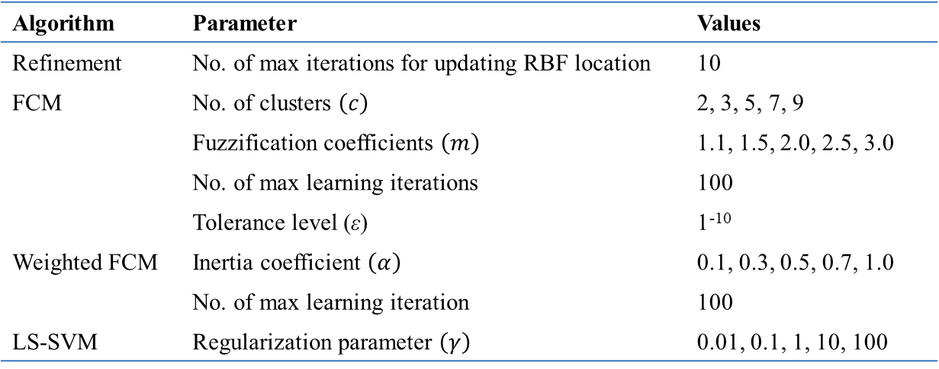

A Study on the Design of RBFNN
classification
Evaluation of classification rate
$$Classification rate\left(CR\right)=\left(1−\frac{N_{err}}{N}\right)×100\left(\%\right)$$
Algorithm | Parameter | Values
Refinement | No. of max iterations for updating RBF location | 10
FCM | No. of clusters $\left(c\right)$ | 2, 3, 5, 7, 9
 | Fuzzification coefficients $\left(m\right)$ | 1.1, 1.5, 2.0, 2.5, 3.0
 | No. of max learning iterations | 100
 | Tolerance level (ε) | 1⁻¹⁰
Weighted FCM | Inertia coefficient $\left(α\right)$ | 0.1, 0.3, 0.5, 0.7, 1.0
 | No. of max learning iteration | 100
LS-SVM | Regularization parameter $\left(γ\right)$ | 0.01, 0.1, 1, 10, 100

Slide 20
A Study on the Design of RBFNN
classification
Data name (Abbreviation) | No. of input variables | No. of class labels | No. of data instances
Zoo (ZO) | 16 | 7 | 101
Hayes (HA) | 5 | 3 | 160
Iris (IR) | 4 | 3 | 150
Wine (WI) | 13 | 3 | 178
Sonar (SO) | 60 | 2 | 208
Seeds (SE) | 7 | 3 | 210
Glass (GL) | 9 | 6 | 214
Heart (HE) | 13 | 2 | 270
Leaf (LE) | 15 | 30 | 340
Liver (LI) | 6 | 2 | 345
Ionosphere (IO) | 34 | 2 | 351
Libras (LB) | 90 | 15 | 360
Monk-2 (M2) | 6 | 2 | 432
Led7digit (L7) | 7 | 10 | 500
Forest (FO) | 27 | 4 | 523

Slide 21
A Study on the Design of RBFNN
classification
Data name (Abbreviation) | No. of input variables | No. of class labels | No. of data instances
WDBC (WD) | 30 | 2 | 569
Balance (BA) | 4 | 3 | 625
Urban Land Cover (ULC) | 147 | 9 | 675
Australian (AU) | 14 | 2 | 690
Pima (PM) | 8 | 2 | 768
Vehicle (VE) | 18 | 4 | 846
Tic-Tac-Toe (TTT) | 9 | 2 | 958
German (GE) | 24 | 2 | 1,000
Hillvalley (HL) | 100 | 2 | 1,212
Banknote (BN) | 4 | 2 | 1,372
Car (CA) | 6 | 4 | 1,728
Titanic (TI) | 3 | 2 | 2,201
Segment (SG) | 19 | 7 | 2,310
Splice (SP) | 60 | 3 | 3,190
Banana (BAN) | 2 | 2 | 5,300
Penbased (PEN) | 16 | 10 | 10,992

Slide 22


A Study on the Design of RBFNN
classification
Data | FCM-based RBFNN |  | Proposed RBFNN
 | Training | Testing | Training | Testing
Zoo | 100.0 | 95.09±7.00 | 99.12±0.46 | 97.09±4.69
Hayes | 88.38±1.61 | 69.78±9.85 | 93.35±1.01 | 71.15±6.24
Iris | 98.00±0.61 | 98.00±4.50 | 98.15±0.39 | 98.00±3.22
Wine | 100.0 | 98.26±3.93 | 100.0 | 100.0
Sonar | 99.20±0.37 | 74.95±9.72 | 100.0 | 90.90±8.82
Seeds | 96.24±0.72 | 95.24±4.49 | 96.82±0.55 | 97.14±2.46
Glass | 82.86±1.43 | 68.78±9.30 | 84.63±1.04 | 72.38±10.4
Heart | 86.75±0.79 | 84.44±6.48 | 86.70±0.87 | 84.81±7.08
Leaf | 93.43±1.36 | 78.23±4.84 | 92.74±0.66 | 79.41±7.07
Liver | 78.52±1.26 | 72.74±10.39 | 75.75±1.19 | 74.47±6.93
Ionosphere | 94.81±0.77 | 88.88±6.25 | 96.77±0.46 | 92.04±3.43
Libras | 98.11±0.53 | 56.39±5.56 | 99.84±0.26 | 86.11±5.85
Monk-2 | 97.76±0.55 | 97.45±2.31 | 97.42±0.44 | 96.52±2.51
Led7digit | 77.71±1.11 | 73.20±8.12 | 75.57±0.77 | 75.40±6.04
Forest | 93.56±0.62 | 89.10±2.84 | 95.77±0.63 | 90.81±5.78
KELL, Weka Wiki

Slide 23








A Study on the Design of RBFNN
classification
Data | FCM-based RBFNN |  | Proposed RBFNN
 | Training | Testing | Training | Testing
WDBC | 98.43±0.33 | 96.65±2.81 | 98.18±0.22 | 97.89±1.61
Balance | 91.34±0.46 | 91.04±3.12 | 91.69±0.20 | 91.52±1.33
Urban Land Cover | 97.49±0.32 | 72.28±4.21 | 90.89±0.57 | 78.79±5.81
Australian | 88.02±0.56 | 87.39±4.48 | 88.00±0.17 | 87.68±1.70
Pima | 80.10±0.49 | 77.19±3.96 | 78.58±0.62 | 77.74±4.43
Vehicle | 87.62±0.39 | 83.68±3.89 | 87.23±0.45 | 83.58±3.40
Tic-Tac-Toe | 98.61±0.40 | 98.12±1.19 | 98.85±0.59 | 98.85±1.03
German | 79.57±0.77 | 77.00±2.40 | 78.56±0.56 | 77.40±5.44
Hillvalley | 91.86±3.84 | 75.26±6.56 | 80.28±5.02 | 79.37±5.48
Banknote | 100.0 | 100.0 | 100.0 | 100.0
Car | 91.72±0.51 | 90.33±2.66 | 91.86±0.66 | 90.91±1.86
Titanic | 79.05±0.19 | 79.05±1.75 | 79.05±0.16 | 79.05±1.46
Segment | 96.21±0.41 | 94.93±1.43 | 95.88±0.33 | 94.59±1.66
Splice | 92.78±0.29 | 86.77±1.28 | 85.19±0.35 | 83.63±1.99
Banana | 89.82±0.26 | 89.53±1.26 | 90.09±0.13 | 90.00±1.51
Penbased | 98.87±0.05 | 98.82±0.42 | 98.54±0.05 | 98.42±0.43
bupa
KELL, Weka Wiki

Slide 24
A Study on the Design of RBFNN
Weka tool
Algorithms | Explanation
BayesNet | 학습데이터에서 개별 클래스의 확률 밀도 함수를 학습하여 베이지안 결정 규칙을 기반으로 데이터의 클래스 결정
Logistic Regression | 선형 알고리즘에 시그모이드 함수가 결합된 이진 분류 알고리즘
MLP (Multilayer perceptron) | 입력층과 출력층 사이에 하나 이상의 은닉층이 존재하는 신경망
SVM | 마진을 최대화하는 방향으로 결정 경계를 정의하는 이진 분류 알고리즘
AdaboostM1 | 한 종류의 패턴분류기를 여러개 결합하여 성능이 낮은 분류기(weak classifier)에 가중치를 부여하여 분류율 개선
k-NN | 새로운 데이터를 입력으로 받았을 때 데이터와 가장 가까운 k개의 학습데이터를 비교
PART (Partial decision tree) | 클래스를 분류하기 위한 결정 목록을 생성하고, 분할 정복 알고리즘을 통해 데이터 패턴이 남아 있지 않을 때까지 반복적으로 규칙을 생성하는 분류 알고리즘
J48 (C4.5) | 결정 트리를 생성하는데 사용되는 알고리즘으로, ID3 (Iterative Dichotomiser 3)의 확장된 형태의 분류 알고리즘
A brief description of the regression models used for generalization performance comparison

Slide 25
A Study on the Design of RBFNN
Data | ElasticNet | Logistic Regression | MLP | SVR | AdaboostM1 |  | k-NN (k=5) | PART | J48 | Proposed model
 |  |  |  |  | Decision Stump | Random Forest
ZO | 96.15±5.77 | 94.85±6.34 | 95.45±5.68 | 93.68±6.95 | 60.43±3.06 | 96.14±5.45 | 95.05±6.70 | 93.41±7.28 | 92.61±7.33 | 97.09±4.69
HA | 60.66±1.77 | 55.68±10.1 | 71.63±11.9 | 55.54±9.81 | 40.73±3.95 | 83.85±10.1 | 34.48±12.6 | 79.90±9.84 | 79.44±9.28 | 71.15±6.24
IR | 93.20±5.92 | 97.20±4.46 | 96.93±4.07 | 96.27±4.58 | 95.40±5.74 | 94.73±4.86 | 95.73±4.60 | 94.20±5.25 | 94.73±5.30 | 98.00±3.22
WI | 98.65±2.56 | 97.23±3.83 | 98.02±3.26 | 98.76±2.73 | 89.37±7.54 | 97.69±3.39 | 95.50±4.62 | 92.08±6.28 | 93.20±5.90 | 100.0
SO | 76.71±9.40 | 72.22±9.08 | 81.61±8.66 | 76.60±8.27 | 75.65±8.48 | 83.91±8.53 | 82.28±9.12 | 77.40±9.43 | 73.61±9.34 | 90.90±8.82
SE | 88.71±6.58 | 94.81±4.98 | 95.24±4.33 | 93.57±4.85 | 90.05±6.87 | 93.67±5.25 | 93.05±5.17 | 92.14±5.68 | 90.90±5.90 | 97.14±2.46
GL | 70.37±8.47 | 63.64±8.83 | 67.53±8.72 | 57.63±9.24 | 44.84±2.89 | 79.80±7.77 | 66.27±8.04 | 70.77±8.61 | 67.76±9.36 | 72.38±10.4
HE | 82.56±6.12 | 83.67±6.43 | 79.41±7.09 | 83.89±6.24 | 81.59±7.07 | 83.04±6.19 | 79.89±6.95 | 77.33±7.81 | 78.15±7.42 | 84.81±7.08
LE | 63.65±7.09 | 74.15±8.40 | 77.56±6.66 | 51.82±6.43 | 7.88±1.77 | 77.74±6.57 | 56.06±8.25 | 61.85±7.48 | 61.76±7.19 | 79.41±7.07
LI | 56.85±4.20 | 68.72±7.98 | 68.73±7.38 | 57.98±1.26 | 65.96±7.11 | 73.08±8.04 | 60.48±7.92 | 65.25±8.12 | 65.84±7.40 | 74.47±6.93
IO | 89.54±4.90 | 87.72±5.57 | 91.06±4.86 | 88.07±5.32 | 90.89±4.64 | 93.25±4.16 | 85.10±4.74 | 90.83±4.66 | 89.74±4.38 | 92.04±3.43
LB | 61.56±6.56 | 68.89±7.97 | 80.39±5.89 | 73.83±5.95 | 11.06±0.79 | 82.53±5.73 | 75.78±6.08 | 68.11±8.44 | 69.31±8.36 | 86.11±5.85
M2 | 76.09±5.99 | 99.91±0.93 | 80.55±5.56 | 96.85±3.19 | 100.0 | 90.32±5.00 | 100.0 | 100.0 | 100.0 | 96.52±2.51
L7 | 73.78±6.48 | 74.12±6.58 | 70.76±6.63 | 73.58±6.72 | 20.16±2.18 | 71.18±6.93 | 73.50±6.45 | 73.12±7.10 | 72.18±6.87 | 75.40±6.04
FO | 86.35±4.77 | 87.66±4.86 | 88.73±3.90 | 89.11±4.06 | 62.60±2.77 | 89.52±4.34 | 88.43±4.29 | 85.10±4.34 | 86.69±4.85 | 90.81±5.78

Slide 26
A Study on the Design of RBFNN
Data | ElasticNet | Logistic Regression | MLP | SVR | AdaboostM1 |  | k-NN (k=5) | PART | J48 | Proposed model
 |  |  |  |  | Decision Stump | Random Forest
WD | 94.40±3.29 | 94.80±3.53 | 96.63±2.43 | 97.56±1.85 | 94.75±3.00 | 96.38±2.52 | 96.88±2.25 | 94.24±2.74 | 93.29±3.58 | 97.89±1.61
BA | 71.56±7.44 | 89.44±3.29 | 91.10±3.03 | 87.41±2.67 | 71.77±4.24 | 81.63±3.89 | 87.90±2.51 | 83.19±3.93 | 77.82±3.50 | 91.52±1.33
ULC | 79.41±3.54 | 57.91±5.12 | 80.53±4.09 | 80.68±3.93 | 34.34±1.20 | 83.94±3.48 | 77.34±4.24 | 75.54±4.76 | 74.67±4.54 | 78.79±5.81
AU | 85.29±3.27 | 86.23±3.43 | 83.35±4.27 | 85.51±3.60 | 86.45±3.44 | 86.88±3.77 | 84.25±3.61 | 83.52±4.58 | 84.35±3.87 | 87.68±1.70
PM | 75.25±4.78 | 77.47±4.39 | 74.75±4.90 | 76.80±4.54 | 74.92±4.80 | 75.77±4.25 | 73.86±4.61 | 73.45±4.51 | 74.49±5.27 | 77.74±4.43
VE | 61.05±3.44 | 79.80±4.03 | 81.39±3.30 | 74.01±3.79 | 39.96±1.87 | 75.03±3.36 | 71.24±4.07 | 72.20±3.63 | 72.23±4.30 | 83.58±3.40
TTT | 69.94±3.74 | 69.19±3.18 | 80.97±5.36 | 65.34±0.41 | 75.90±4.07 | 95.96±1.94 | 83.96±3.40 | 98.11±1.89 | 89.35±3.88 | 98.85±1.03
GE | 72.88±3.64 | 76.92±3.47 | 71.09±3.61 | 76.72±3.47 | 73.58±3.39 | 76.76±3.45 | 71.24±3.55 | 69.63±4.27 | 73.57±3.93 | 77.40±5.44
HL | 50.49±0.16 | 99.72±0.54 | 56.59±3.13 | 57.81±8.25 | 50.35±1.37 | 61.44±3.49 | 56.07±4.32 | 50.49±0.16 | 50.49±0.16 | 79.37±5.48
BN | 91.98±2.23 | 99.04±0.78 | 99.96±0.22 | 97.98±1.12 | 94.78±1.78 | 99.34±0.68 | 99.85±0.29 | 98.70±0.96 | 98.55±1.03 | 100.0
CA | 87.07±2.41 | 83.70±2.38 | 93.93±1.77 | 84.70±2.27 | 70.02±0.16 | 96.83±1.38 | 91.97±2.12 | 96.98±1.41 | 96.65±1.55 | 90.91±1.86
TI | 77.43±2.44 | 77.60±2.30 | 77.78±2.32 | 77.60±2.30 | 77.60±2.30 | 78.97±1.81 | 78.95±1.81 | 79.03±1.74 | 79.03±1.74 | 79.05±1.46
SG | 91.57±1.98 | 95.68±1.20 | 96.36±1.10 | 92.90±1.52 | 28.53±0.14 | 98.17±0.78 | 95.29±1.31 | 96.83±1.10 | 96.91±1.09 | 94.59±1.66
SP | 96.25±0.93 | 85.28±1.60 | 87.19±1.81 | 85.64±1.71 | 63.32±1.51 | 95.19±1.18 | 69.75±2.69 | 92.71±1.53 | 93.25±1.54 | 83.63±1.99
BAN | 72.32±2.14 | 55.84±1.97 | 72.68±2.38 | 55.17±0.09 | 69.14±3.06 | 89.01±1.33 | 88.92±1.11 | 86.78±2.05 | 89.07±1.22 | 90.00±1.51
PEN | 87.83±1.00 | 95.54±0.68 | 94.50±0.60 | 98.01±0.37 | 20.38±0.18 | 99.16±0.28 | 99.27±0.22 | 96.82±0.54 | 96.52±0.51 | 98.42±0.43

Slide 27
A Study on the Design of RBFNN
Regression
◈ Statistical Analysis of the Proposed Model Using the Friedman Test A type of non-parametric statistical method Statistical analysis of the proposed model is conducted based on the average ranks of the models.
◈ Procedure of the Friedman Test
Formulation of the null hypothesis: "There is no significant difference between the proposed model and the other models; thus, the observed average ranks are not meaningful."
If the null hypothesis is rejected, => conduct a post-hoc test for detailed analysis

Slide 28
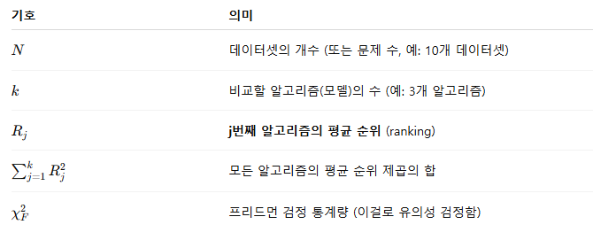
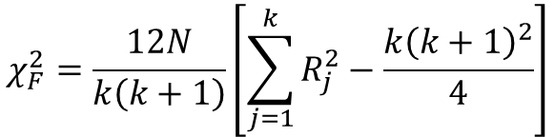
A Study on the Design of RBFNN
Regression
Null hypothesis
$$χ_{F}^{2}=\frac{12N}{k\left(k+1\right)}\left[\sum_{j=1}^{k}{R_{j}^{2}}−\frac{k{\left(k+1\right)}^{2}}{4}\right]$$
 | ElasticNet | Isotonic Regression | Linear Regression | MLP | SVR | RBF Regression | M5Rules | Proposed Model
Average rank | 5.8226 | 6.5161 | 4.6613 | 4.9355 | 5.7742 | 3.7258 | 2.8710 | 1.6935
$$χ_{F}^{2}=\frac{12∙31}{8∙9}\left[\left({5.8226}^{2}+{6.5161}^{2}+{4.6613}^{2}+{4.9355}^{2}+{5.7742}^{2}+{3.7258}^{2}+{2.8710}^{2}+{1.6935}^{2}\right)−\frac{8∙9^{2}}{4}\right]$$ $=97.0430$

Slide 29
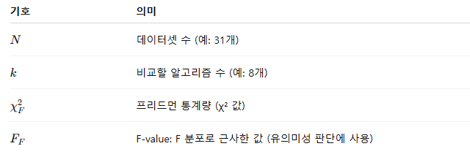

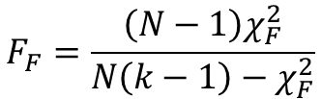
A Study on the Design of RBFNN
Regression
프리드먼 검정통계량$\left(χ_{F}^{2}\right)$의 분포표 ➔ $χ_{F}^{2}$에 대한 분포표를 만들기 어려움
$$F_{F}=\frac{\left(N−1\right)χ_{F}^{2}}{N\left(k−1\right)−χ_{F}^{2}}$$
$$F_{F}=\frac{30∙97.0430}{31∙7−97.0430}=24.2694≅24.27$$

Slide 30
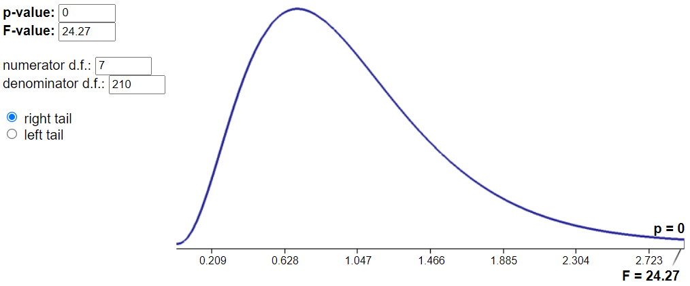
A Study on the Design of RBFNN
Regression
P-value=0 -> Rejection (The observed average ranks are statistically significant)

Slide 31
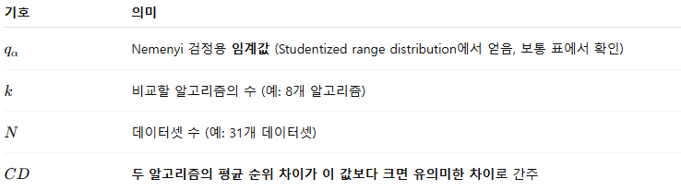
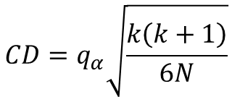
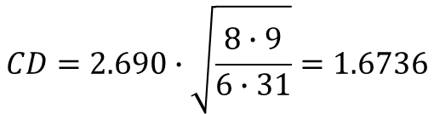
A Study on the Design of RBFNN
Regression
Post-hoc test
Bonferroni-Dunn
No. of models | 2 | 3 | 4 | 5 | 6 | 7 | 8 | 9 | 10
$$q_{0.05}$$ | 1.960 | 2.241 | 2.394 | 2.498 | 2.576 | 2.638 | 2.690 | 2.724 | 2.773
$$q_{0.10}$$ | 1.645 | 1.960 | 2.128 | 2.241 | 2.326 | 2.394 | 2.420 | 2.498 | 2.539
Critical difference(CD)
$$CD=q_{α}\sqrt{\frac{k\left(k+1\right)}{6N}}$$
$$CD=2.690∙\sqrt{\frac{8∙9}{6∙31}}=1.6736$$

Slide 32
A Study on the Design of RBFNN
Regression
Post-hoc test

Slide 33

A Study on the Design of RBFNN
classification
 | ElasticNet | Logistic Regression | MLP | SVR | AdaboostM1 |  | k-NN (k=5) | PART | J48 | Proposed model
 |  |  |  |  | Decision Stump | Random Forest
 | 6.9677 | 5.5161 | 4.9032 | 5.8065 | 8.1129 | 3.3065 | 5.8871 | 6.1613 | 6.1452 | 2.1935
$$χ_{F}^{2}=\frac{12∙31}{10∙11}\left[\left({6.9677}^{2}+{5.5161}^{2}+{4.9032}^{2}+{5.8065}^{2}+{8.1129}^{2}+{3.3065}^{2}+{5.8871}^{2}+{6.1613}^{2}+{6.1452}^{2}+{2.1935}^{2}\right)−\frac{10∙{11}^{2}}{4}\right]$$ $=88.5343$
Evaluate FF
$$F_{F}=\frac{30∙88.5343}{31∙9−88.5343}=13.9449≅13.95$$

Slide 34
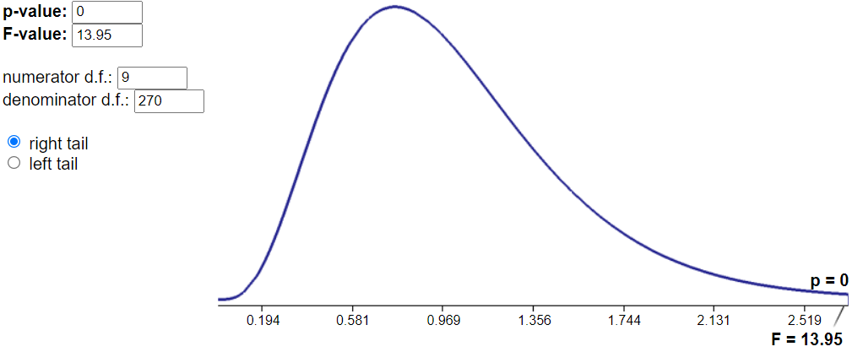
A Study on the Design of RBFNN
classification

Slide 35
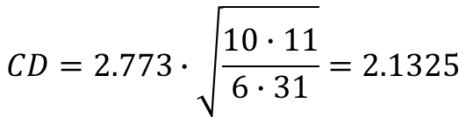
A Study on the Design of RBFNN
classification
Bonferroni-Dunn
No. of models | 2 | 3 | 4 | 5 | 6 | 7 | 8 | 9 | 10
$$q_{0.05}$$ | 1.960 | 2.241 | 2.394 | 2.498 | 2.576 | 2.638 | 2.690 | 2.724 | 2.773
$$q_{0.10}$$ | 1.645 | 1.960 | 2.128 | 2.241 | 2.326 | 2.394 | 2.420 | 2.498 | 2.539
Critical difference(CD)
$$CD=2.773∙\sqrt{\frac{10∙11}{6∙31}}=2.1325$$

Slide 36
A Study on the Design of RBFNN
classification
Post-hoc test

